Slide 1
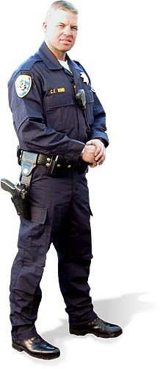
TEXAS HEALTH AND SAFETY CODE
INSTRUCTOR: OFFICER COLE LANGSTON
CARROLLTON POLICE DEPARTMENT

Slide 2
LEARNING OBJECTIVES
The student will be able to explain the offense of possession of tobacco products by a minor
The student will be able to explain the offense classifications relating to “Possession of Marihuana.”
The student will be able to explain the offenses of delivery of drugs to a child.
The student will be able to explain the offenses addressing drug paraphernalia.
Learning objective: The student will be able to explain the meaning of a “Drug Free Zone.”
Learning objective: The student will be able to explain the offense the use of children in the delivery of drugs.
Learning objective: The student will be able to explain the offense of delivery or manufacture of drugs.

Slide 3
Possession of Tobacco by a Minor 161.252
An individual who is younger than 18 years of age commits an offense if the individual:
Possesses, purchases, consumes, or accepts a cigarette or tobacco product
Falsely represents himself or herself to be 18 years of age or older by displaying proof of age that is false, fraudulent, or not actually proof of the individual's own age in order to obtain possession of, purchase, or receive a cigarette or tobacco product
Exceptions:
Possesses in presence of parent, guardian, or spouse
Possess in presence of an employer if required in performance of duties
Minor stings

Slide 4
Possession of Marijuana 481.121
A person commits an offense if the person knowingly or intentionally possesses a usable quantity of marihuana
Class B Misdemeanor: 2 ounces or less
Class A misdemeanor: > 2 ounces to four ounces
Other penalties listed

Slide 5
Delivery of Controlled Substance or Marijuana to Child 481.122
A person commits an offense if the person knowingly delivers a controlled substance listed in Penalty Group 1, 1-A, 2, or 3 or knowingly delivers marihuana and the person delivers the controlled substance or marihuana to a person:
Who is a child (under 18);
Who is enrolled in a public or private primary or secondary school; or
Who the actor knows or believes intends to deliver the controlled substance or marihuana to a person described in 1 or 2 above

Slide 6
Affirmative defense to prosecution under this section that:
The actor was a child when the offense was committed; or
The actor:
Was younger than 21 years of age when the offense was committed;
Delivered only marihuana in an amount equal to or less than one-fourth ounce; and
Did not receive remuneration for the delivery
2nd Degree Felony

Slide 7
Possession or Delivery of Drug Paraphernalia 481.125
A person commits an offense if the person knowingly or intentionally uses or possesses with intent to use drug paraphernalia (as listed)
Class C Misdemeanor
A person commits an offense if the person knowingly or intentionally delivers, possesses with intent to deliver, or manufactures with intent to deliver drug paraphernalia knowing that the person who receives or who is intended to receive the drug paraphernalia intends that it be used (as listed)
Class A misdemeanor
2nd Offense: enhanced to jail term of 90 day to 1 year
State Jail Felony: If suspect is 18 or over and recipient is under 18 and at least 3 years younger than suspect

Slide 8
Must show into to use paraphernalia to plant, propagate, cultivate, grow, harvest, manufacture, compound, convert, produce, process, prepare, test, analyze, pack, repack, store, contain, or conceal a controlled substance in violation of this chapter or to inject, ingest, inhale, or otherwise introduce into the human body a controlled substance in violation of this chapter

Slide 9
Drug Free Zones HSC 481.134
School: private or public elementary school, private or public secondary school, or a daycare
Playground: Outdoor facility that is not on the premises of a school and that is intended for recreation; open to the public; and contains three or more play stations intended for the recreation of children, such as slides, swing sets, and teeterboards
Video arcade facility: Open to the public, including persons 17 or younger; intended for use of pinball or video machines, contains at least 3 pinball or video machines
Youth center: Recreation facility or gym intended primarily for use by persons 17 or younger and regularly provides athletic, civic, or cultural activities.

Slide 10
Enhances penalties for included drug offenses committed in, on, or within 1,000 feet of a school or on a school bus
Adds five years and doubles fine
Included offenses:
Manufacture or Delivery of PG 1, 2, 3, 4 (2nd degree and higher)
Possession of PG 1, 2, 3, 4 (3rd degree or higher)
Delivery of Marijuana (2nd degree or higher)
Possession of Marijuana (3rd degree or higher

Slide 11
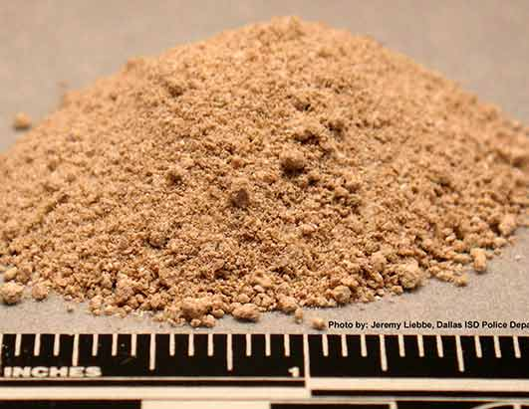
Enhances State Jail Felony to 3rd Degree Felony for included drug offenses committed in, on, or within 1,000 feet of any real property that is owned, rented, or leased to a school or school board or on a school bus, or the premises of a public or private youth center, or a playground
Included offenses:
Manufacture or Delivery of PG1
Manufacture or Delivery of PG2
Manufacture or Delivery of PG3 or 4
Possession of PG 1
Possession of PG2
Delivery of Marijuana
Possession of Marijuana

Slide 12
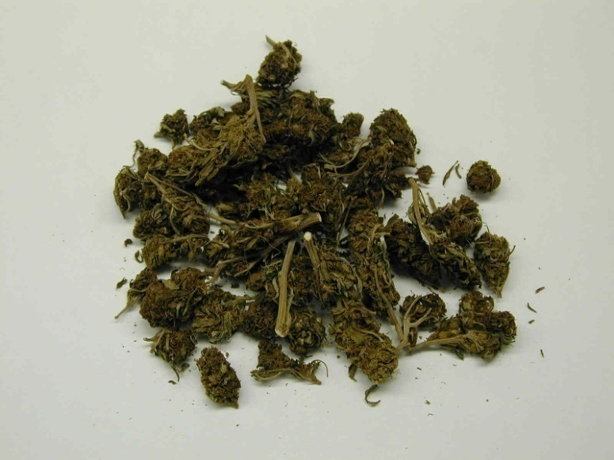
Enhances Class A Misdemeanor to State Jail Felony for included drug offenses committed in, on, or within 1,000 feet of any real property that is owned, rented, or leased to a school or school board or on a school bus, or the premises of a public or private youth center
Included offenses:
Possession of PG 3
Manufacture, Delivery, or Possession of Miscellaneous Substances
Delivery of Marijuana
Possession of Marijuana

Slide 13
Enhances Class B Misdemeanor to Class A Misdemeanor for included drug offenses committed in, on, or within 1,000 feet of any real property that is owned, rented, or leased to a school or school board or on a school bus, or the premises of a public or private youth center, or a playground
Included offenses:
Possession of PG 4
Manufacture, Delivery, or Possession of Miscellaneous Substances
Delivery of Marijuana
Possession of Marijuana
The enhancement from Class B to A does not apply if the offense was committed in a private residence and no minor (under 18) was present

Slide 14
Use of Child in Commission of Offense 481.140
Offenses enhanced by one degree if defendant used or attempted to use a child younger than 18 to commit or assist in the commission of the offense
First Degree Felony if threat of force or force used against the child or another to gain the child’s assistance
Included Offenses:
Manufacture or Delivery of Substance in PG 1, 1A, 2, 3, 4
Delivery of Marijuana
Delivery of Controlled Substance or Marihuana to Child

Slide 15
Unlawful Delivery or Manufacture with Intent to Deliver 482.002
A person commits an offense if the person knowingly or intentionally manufactures with the intent to deliver or delivers a simulated controlled substance and the person:
Expressly represents the substance to be a controlled substance;
Represents the substance to be a controlled substance in a manner that would lead a reasonable person to believe that the substance is a controlled substance; or
States to the person receiving or intended to receive the simulated controlled substance that the person may successfully represent the substance to be a controlled substance to a third party
Not a defense to prosecution that the person manufacturing with the intent to deliver or delivering the simulated controlled substance believed the substance to be a controlled substance
State Jail Felony

Slide 16
Tattoos Prohibited for Certain Persons 146.012
A tattooist may not tattoo a person younger than 18 years of age
Exception: With parental consent in order to cover other tattoos that contain
Obscene or offensive language or symbols
Gang-related names, symbols, or markings
Drug-related names, symbols, or pictures
Other words, symbols, or markings that the person's parent or guardian considers would be in the best interest of the person to cover

Slide 17
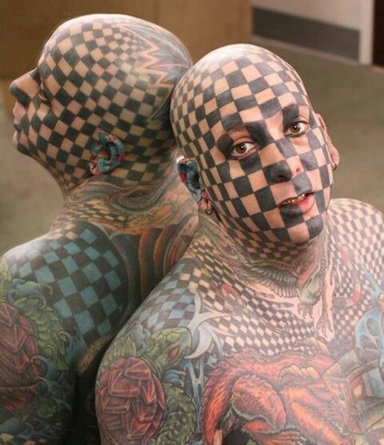
A person younger than 18 years of age commits an offense if the person falsely states that the person is 18 years of age or older or presents any document that indicates that the person is 18 years of age or older to a person engaged in the operation of a tattoo studio
Class B misdemeanor

Slide 18
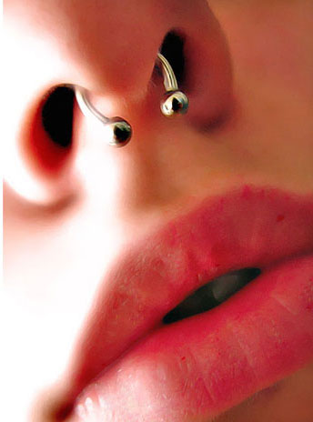
Body Piercing Prohibited Without Parental Consent 146.0125
A person may not perform body piercing on an individual younger than 18 years of age without the consent of a parent, managing conservator, or guardian of the individual
A person younger than 18 years of age commits an offense if the person falsely states that the person is 18 years of age or older or presents any document that indicates that the person is 18 years of age or older to a person engaged in the operation of a body piercing studio
Class B Misdemeanor.

Slide 19
Offense; Criminal Penalty 146.018
A person commits an offense if the person violates this chapter or a rule adopted under this chapter
One rule is that persons giving tattoos or body piercings must be licensed
Department of Health can also fine up to $5,000 per day of violation (HSC 146.019)
Department of Health can seek civil injunction and penalties of up to $5,000 per day (HSC 146.020)
Class A misdemeanor.

Slide 20
Questions
Possession of tobacco products by a minor is a Class C misdemeanor.
true____ false_____
The delivery of controlled substances to a child is a felony of the second degree.
true___ false____

Slide 21
TEXAS HEALTH AND SAFETY CODE
INSTRUCTOR: OFFICER COLE LANGSTON
CARROLLTON POLICE DEPARTMENT

